Slide 1


Tutorial Mobilenet V2
2020.12.10
Hayeon Lee

Slide 2
Environments
Prerequisites
● Ubuntu 16.04
● Python >= 3.5
● Tensorflow >= 1.8
pip package
● numpy >= 1.14
● opencv-python 4.1.0.25
● matplotlib 3.03
PPT & Code materials
● https://github.com/HayeonLee/1210_vision

Slide 3
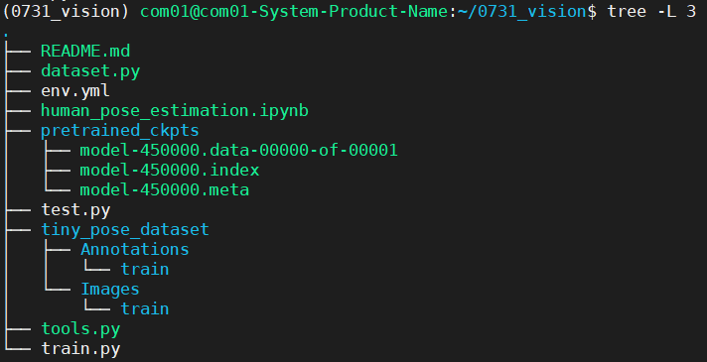
Human Pose Estimation using Mobilenet V2
Quick start
The configuration of code and dataset.
train.py,
test.py
tiny_pose_
dataset
tools.py
dataset.py
Abstract

Slide 4
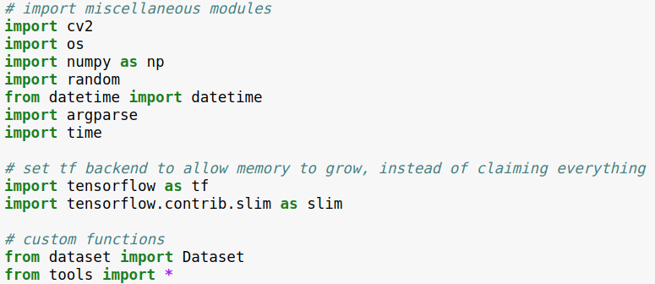
Human Pose Estimation using Mobilenet V2
Module Import
TF.Slim is effective to remove redundant code.
ex) slim.arg_scope, slim.stack

Slide 5
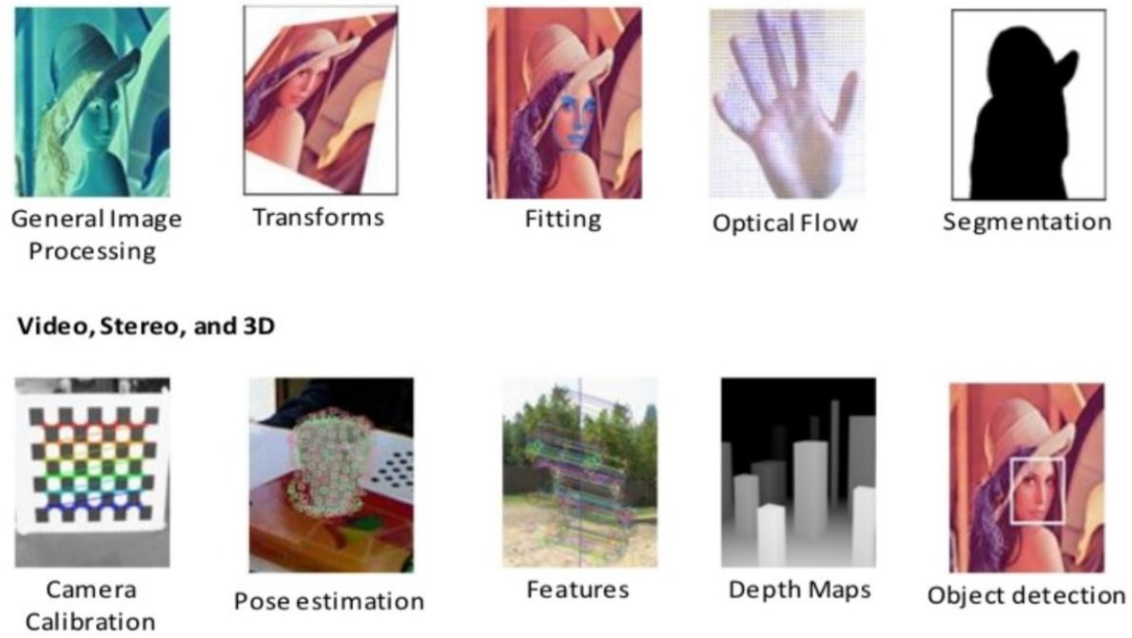
Introduction to OpenCV
Image Processing & Video Analysis

Slide 6
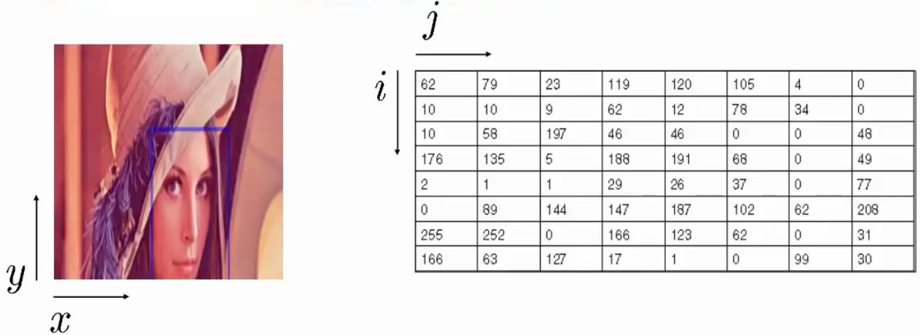
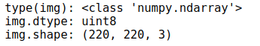
Image vs Matrix
Digital images are typically stored in a matrix.
There are many different file formats
All image information is stored as numpy matrix/
Print type, dtype, and shape information of numpy matrix.

Slide 7
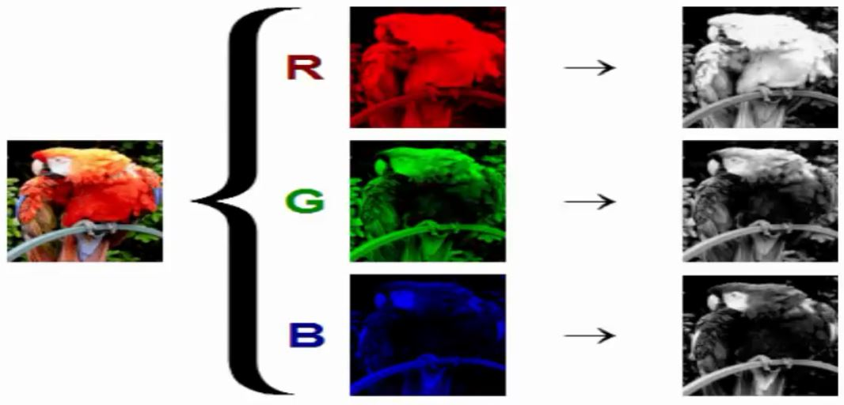
How do computers see images?
In grayscale images, each pixel represents the intensity that means how bright or dark the pixel is.
In color images, each pixel is composed by Red, Green, and Blue channel.

Slide 8
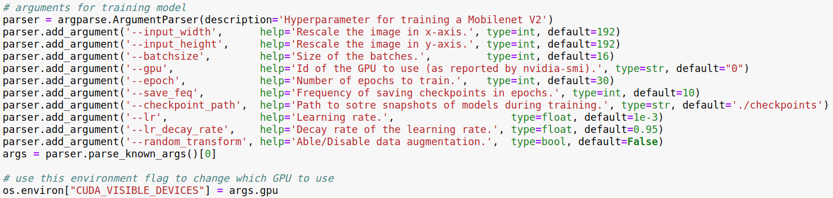
Human Pose Estimation using Mobilenet V2
Parsers – 10 arguments
- 10 optional arguments

Slide 9
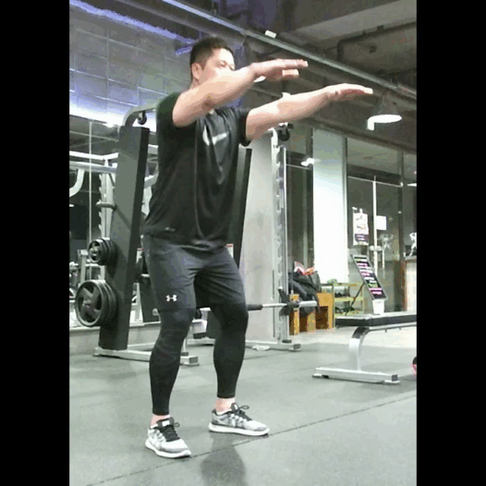
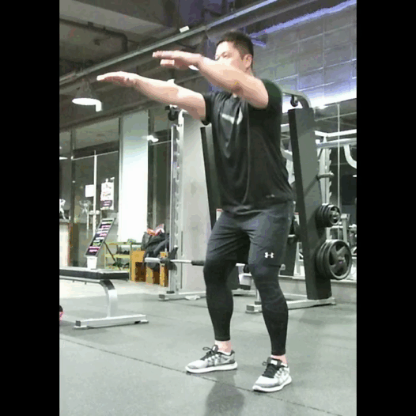
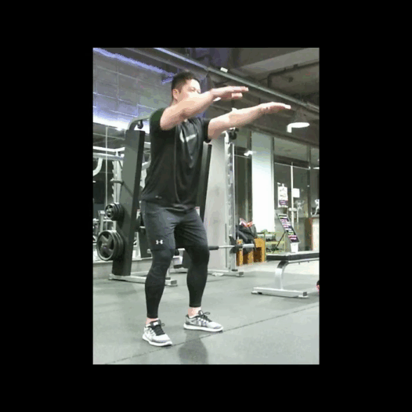
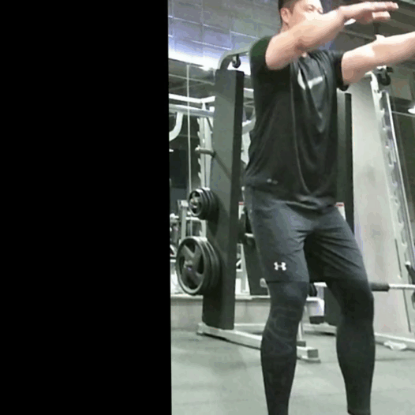
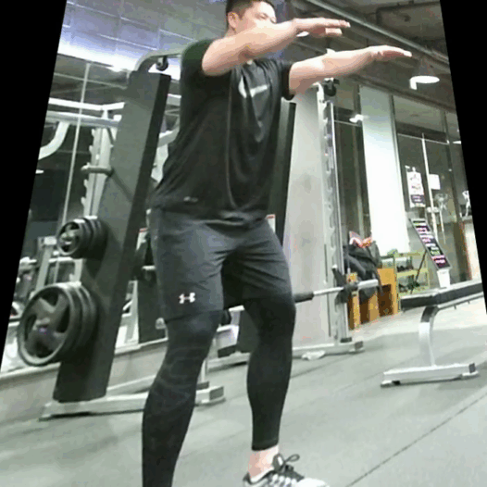
Human Pose Estimation using Mobilenet V2
Reproducibility
There is another way to prevent overfitting problem called data augmentation which is a strategy that enables practitioners to significantly increase the diversity of data.
True
Original
Flip
Scaling
Shift
Perspective Transform

Slide 10
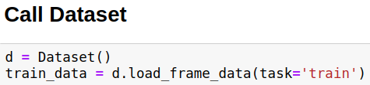
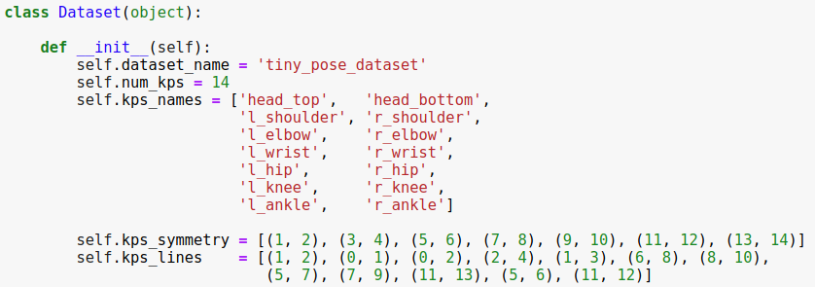
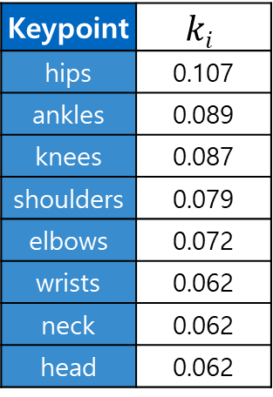
Human Pose Estimation using Mobilenet V2
Data Loading and Processing: Dataset
Keypoint | $$ki$$
hips | 0.107
ankles | 0.089
knees | 0.087
shoulders | 0.079
elbows | 0.072
wrists | 0.062
neck | 0.062
head | 0.062
Visualization of each keypoint and tolerance
14 types of keypoints.
Visibility flag annotations
357 images (train/val)

Slide 11
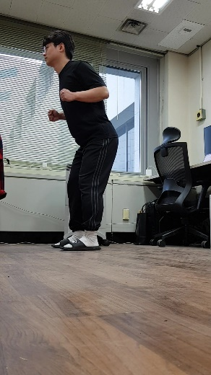
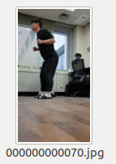
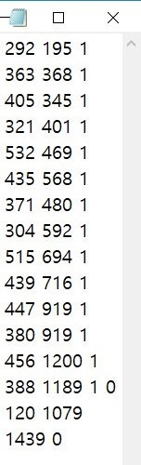
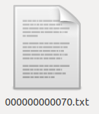
Human Pose Estimation using Mobilenet V2
Data Loading and Processing
Let’s see how to load data
RGB
14 keypoints
(x, y, flags)

Slide 12
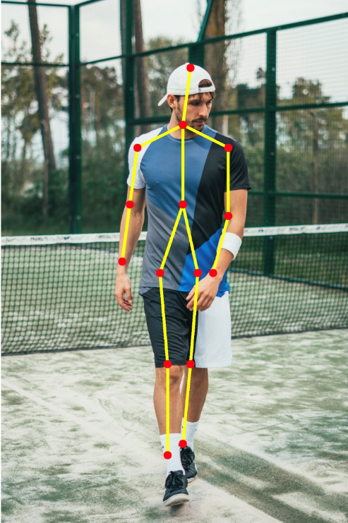
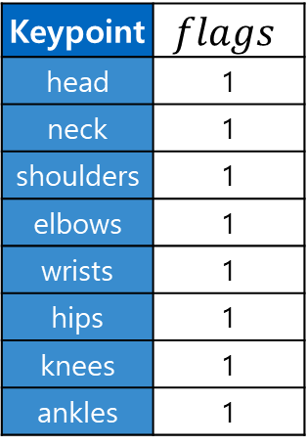
Human Pose Estimation using Mobilenet V2
Data Loading and Processing: Occlusion
Annotation info provide position of body parts and its visibility.
Keypoint | $$flags$$
head | 1
neck | 1
shoulders | 1
elbows | 1
wrists | 1
hips | 1
knees | 1
ankles | 1
14 keypoints
(x, y, flags)
All body part is visible.

Slide 13
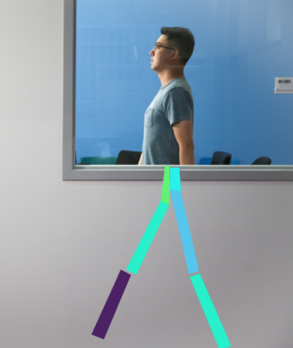
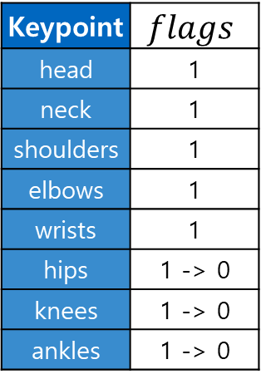
Human Pose Estimation using Mobilenet V2
Data Loading and Processing: Occlusion
Annotation info provide position of body parts and its visibility.
Keypoint | $$flags$$
head | 1
neck | 1
shoulders | 1
elbows | 1
wrists | 1
hips | 1 -> 0
knees | 1 -> 0
ankles | 1 -> 0
14 keypoints
(x, y, flags)
We don’t know what pose person is doing

Slide 14
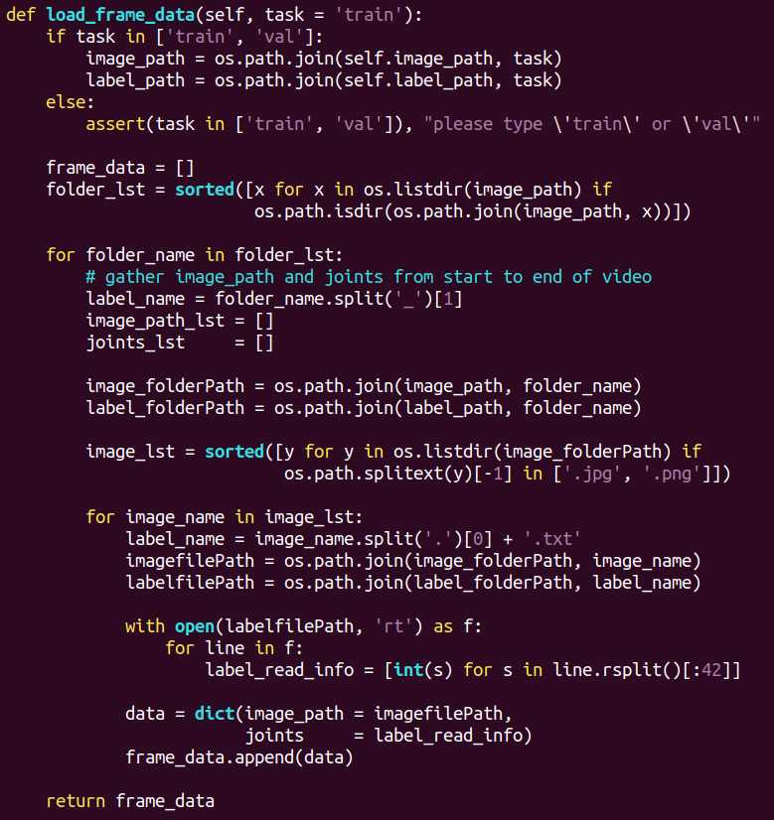
Human Pose Estimation using Mobilenet V2
Data Loading and Processing
Let’s see how to load data
RGB
14 keypoints
(x, y, flags)

Slide 15
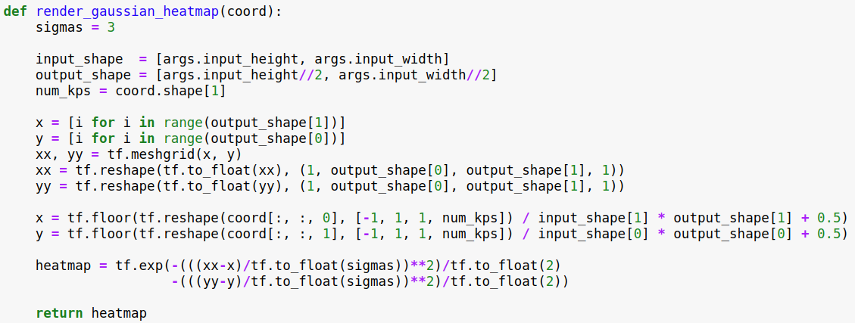
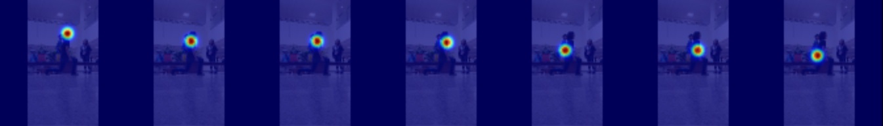
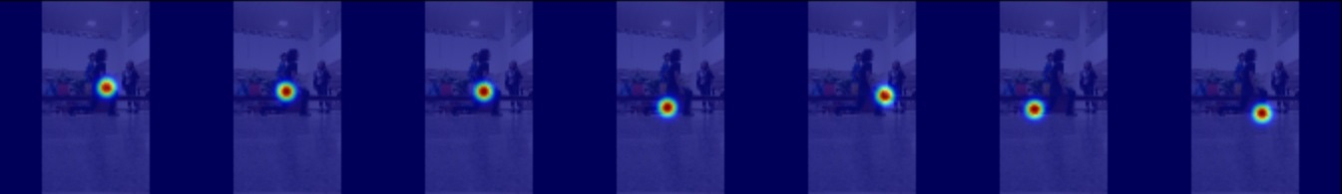
Human Pose Estimation using Mobilenet V2
Data Loading and Processing: Preprocessing (Gaussian Blur)
This function is used to generate the target heatmap for training using ground truth coordinate information
14 keypoints
head
neck
L-shoulder
R-shoulder
L-elbow
R-elbow
L-wrist
(x, y, flags)
R-wrist
L-hip
R-hip
L-knee
R-knee
L-ankle
R-ankle

Slide 16
Human Pose Estimation using Mobilenet V2
Data Loading and Processing: Preprocessing (Gaussian Blur)
This function is used to generate the target heatmap for training using ground truth coordinate information

Slide 17
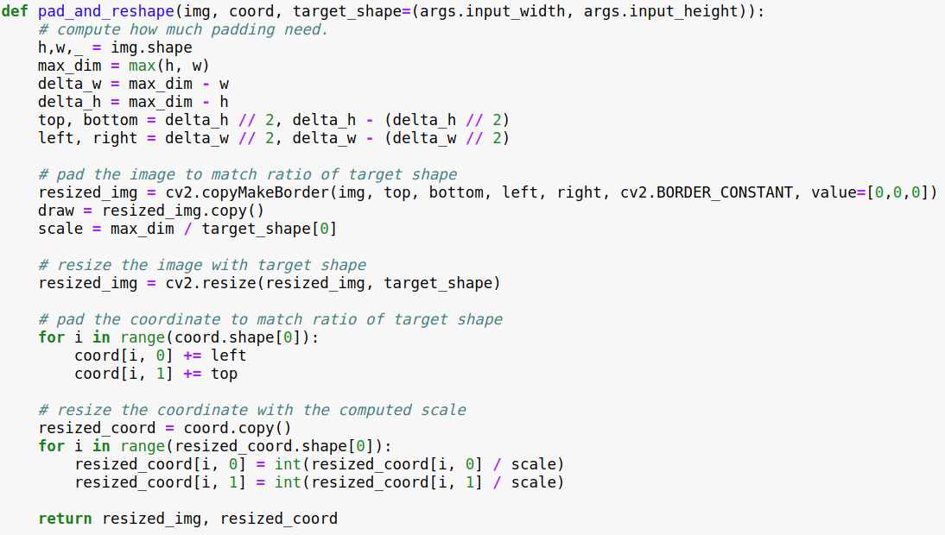
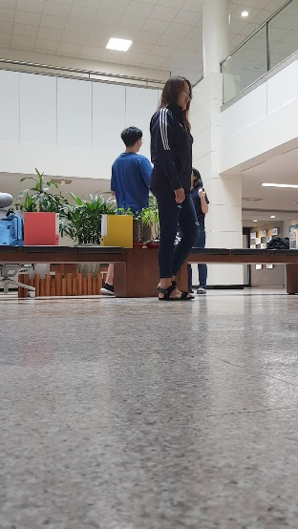
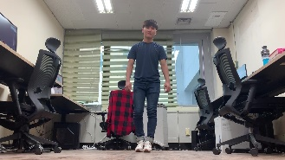
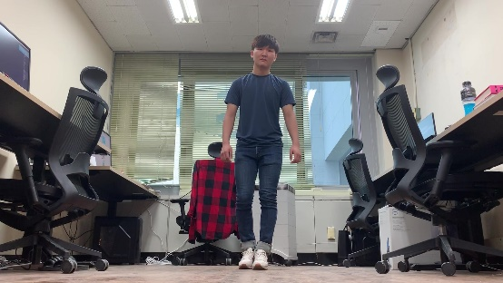

Human Pose Estimation using Mobilenet V2
Data Loading and Processing: Transforms
This function make all the inputs including image and coordinate to a specific target size.
padding
resize

Slide 18
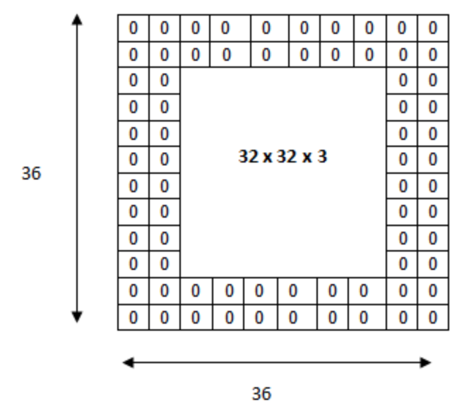
Human Pose Estimation using Mobilenet V2
Data Loading and Processing: Transforms
This function make all the inputs including image and coordinate to a specific target size.

Slide 19
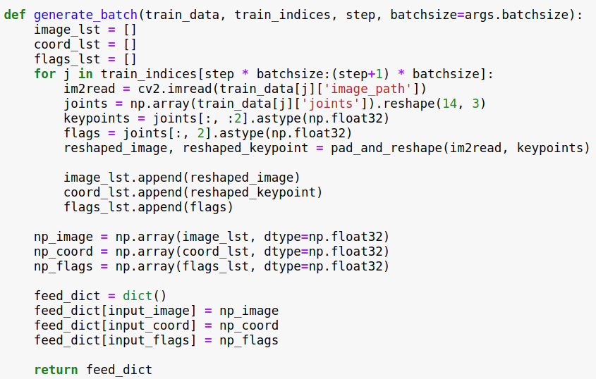


Human Pose Estimation using Mobilenet V2
Data Loading and Processing: DataLoader
This function create feed_dict for tensorflow session from training data matching image and coordinate information temporally.
. . .
. . .
Batch
Time
Image - Annotation

Slide 20
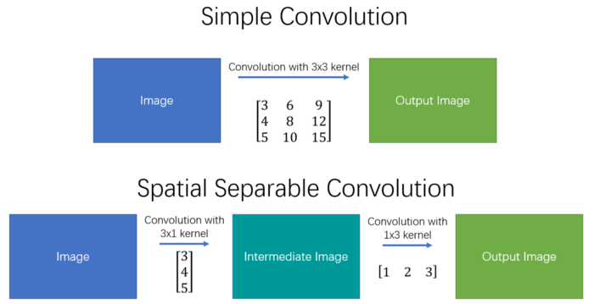
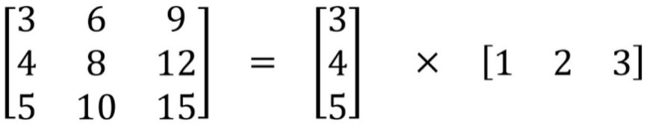
Separable Convolutions
The spatial separable convolution is so named because it deals primarily with the spatial dimensions of an image and kernel: the width and the height.
Separating a 3x3 kernel spatially
Computation Cost : 9 -> 6
Instead of doing one convolution with 9 multiplications, we do two convolutions with 3 multiplications each (6 in total) to achieve the same effect.

Slide 21
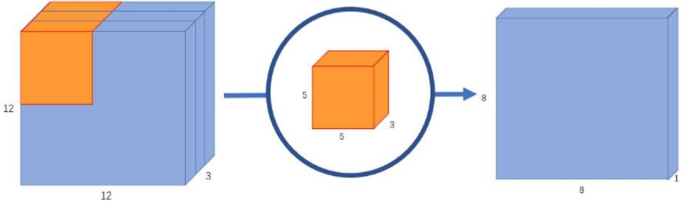
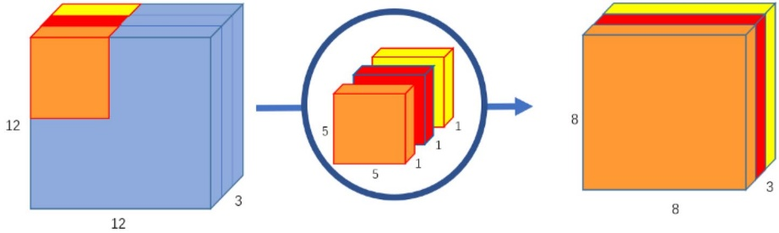
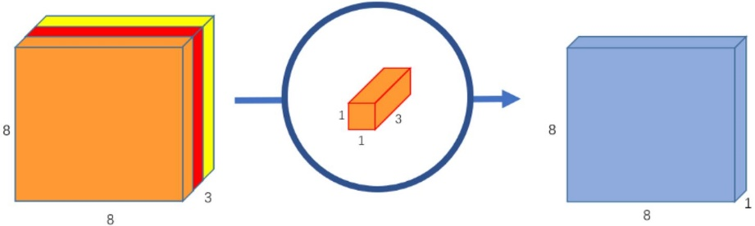
Depthwise Separable Convolutions
Depthwise separable convolution is a key building block of MobileNet V2.
Depthwise convolution
Pointwise convolution

Slide 22
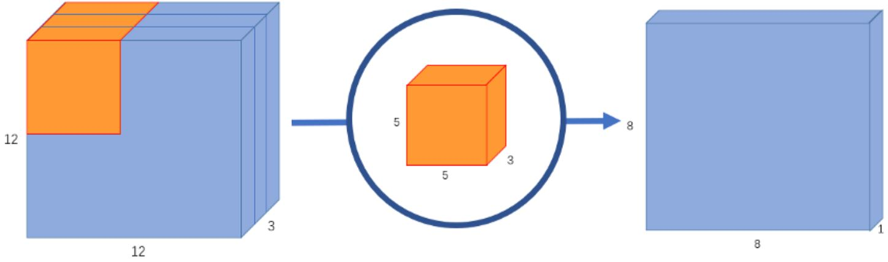
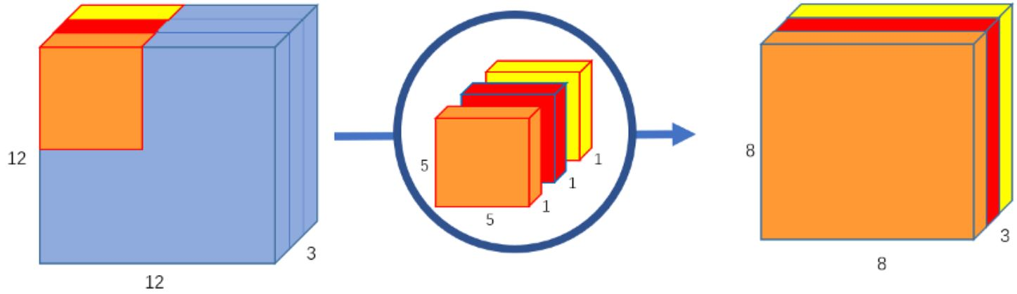
Depthwise Convolutions
The filter of depthwise convolution only perform spatial convolution, not channel-wise convolution operation.

Slide 23

Pointwise Convolutions
The pointwise convolution is so named because it uses a 1x1 kernel, or a kernel that iterates through every single point.

Slide 24
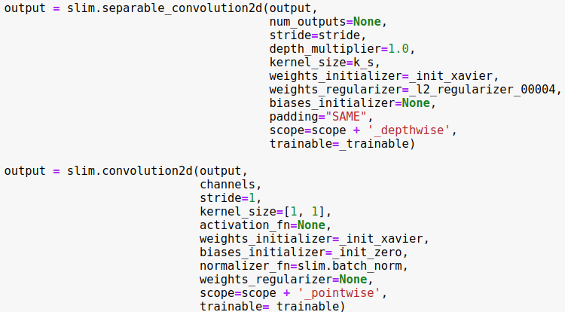
Depthwise Separable Convolutions
The filter of depthwise convolution only perform spatial convolution, not channel-wise convolution operation.

Slide 25



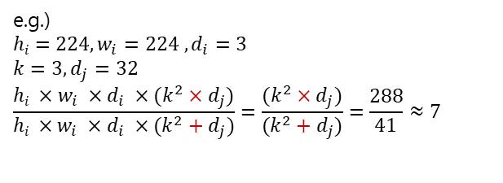
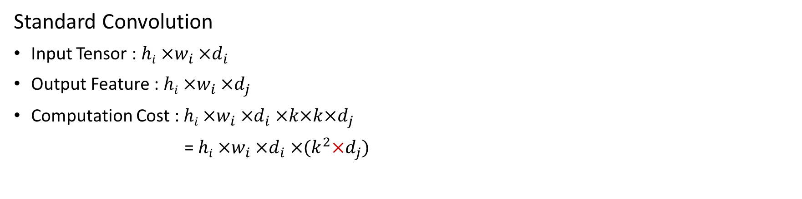
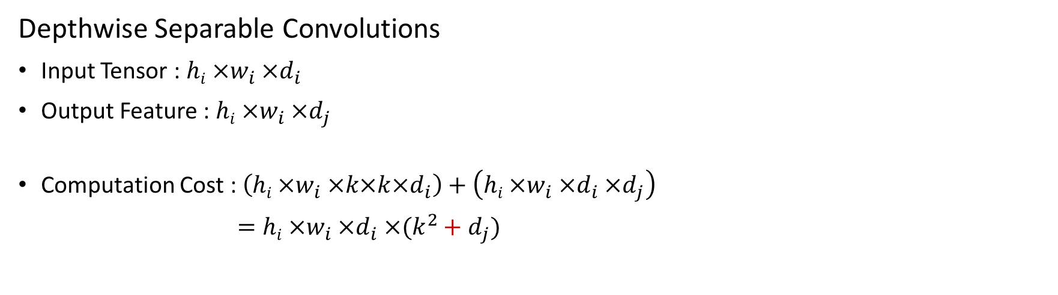
Depthwise Separable Convolutions
Standard Convolution
Input Tensor : $hi ×w_{i} ×d_{i}$
Output Feature : $hi ×w_{i} ×d_{j}$
Computation Cost : $hi ×w_{i} ×d_{i} ×k×k×d_{j}$
= $hi ×w_{i} ×d_{i} ×(k^{2}×d_{j})$
Depthwise Separable Convolutions
Input Tensor : $hi ×w_{i} ×d_{i}$
Output Feature : $hi ×w_{i} ×d_{j}$
Computation Cost : $\left(hi ×w_{i} ×k×k×d_{i}\right)+\left(hi ×w_{i} ×d_{i} ×d_{j}\right)$
$=hi ×w_{i} ×d_{i} ×(k^{2}+d_{j})$
depthwise convolution
pointwise convolution
e.g.)
$$hi=224, w_{i}=224 , d_{i}=3$$
$$k=3, d_{j}=32$$
$$\frac{hi ×w_{i} ×d_{i} ×(k^{2}×d_{j})}{hi ×w_{i} ×d_{i} ×(k^{2}+d_{j})}=\frac{(k^{2}×d_{j})}{(k^{2}+d_{j})}=\frac{288}{41}≈7$$

Slide 26
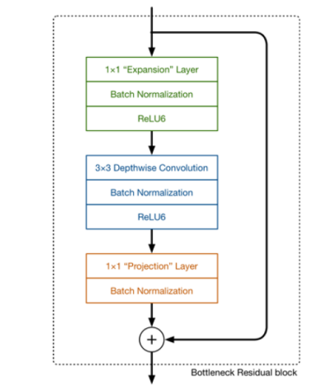
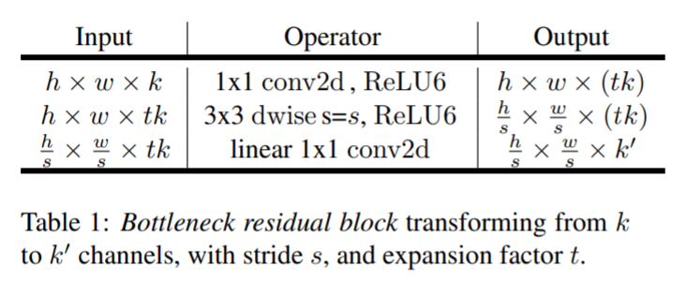
Bottleneck Residual block
Basic building block is a bottleneck depth-separable convolution with residuals.
1) Inverted residuals
2) Linear Bottleneck

Slide 27
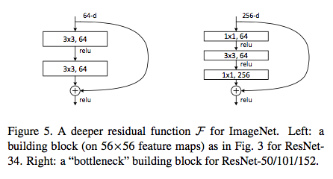
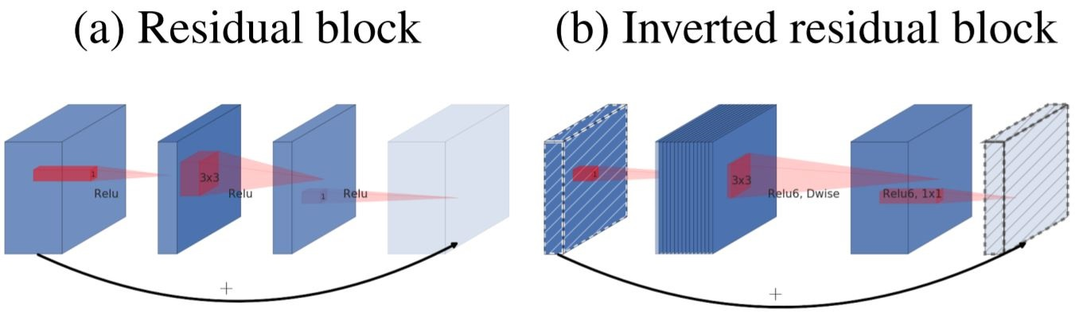
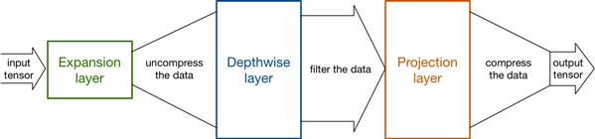
1) Inverted Residuals

Slide 28
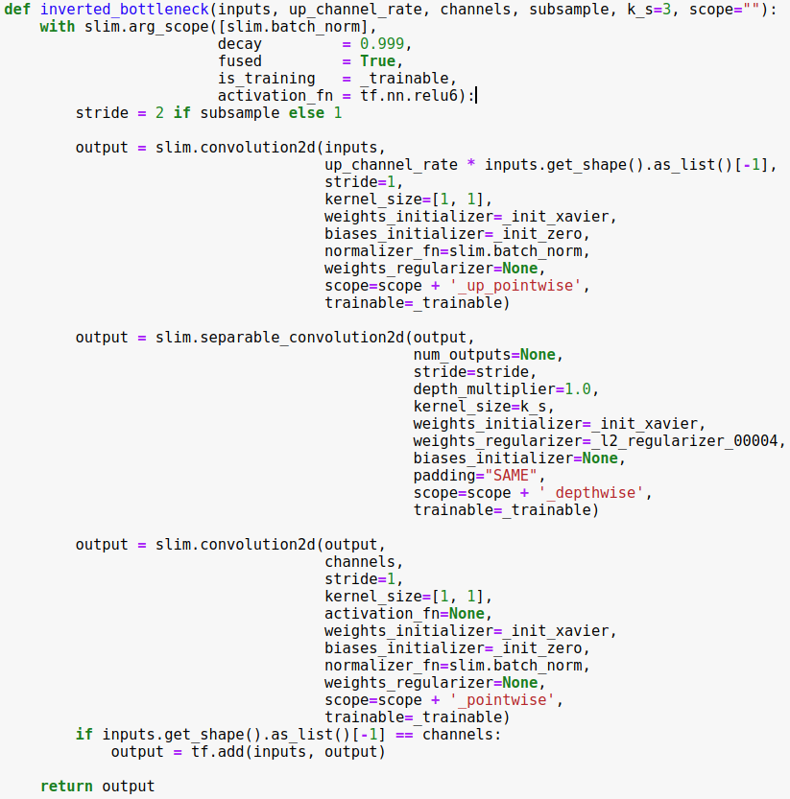
1) Inverted Residuals
Uncompress
Compress

Slide 29





2) Linear Bottlenecks
When the manifold of interest is low-dimensional, we can capture this by inserting linear bottleneck layers into the convolutional blocks. Experimental evidence suggests it.
Manifold
Examples of ReLU transformations of low-dimensional manifolds embedded in higher-dimensional spaces

Slide 30


2) Linear Bottlenecks
Non-zero volume after ReLU transformation corresponds to linear transformation.
Removing the non-linear activations (e.g. ReLU) to prevent the model from information loss.
activation = relu6
Examples of ReLU transformations of low-dimensional manifolds embedded in higher-dimensional spaces
activation = relu6
activation = None
-> Linear

Slide 31



MobileNet V2
In this code, manipulate output channel per block to set final channel = 512.
$t :$ up_channel_ratio
$c :$ the number of output channels
$n :$ repeated time
$s :$ stride

Slide 32



MobileNet V2
In stem layer, perform normal conv2d because input form is low-dimensional.
Input | Operator | t | c | n | s
$${224}^{2}×3$$ | conv2d | - | 24 | 1 | 2
$${112}^{2}×3$$ | bottleneck | 1 | 12 | 2 | 1(2)
$${56}^{2}×3$$ | bottleneck | 6 | 18 | 5 | 1(2)
$${28}^{2}×3$$ | bottleneck | 6 | 24 | 5 | 1(2)
$${14}^{2}×3$$ | bottleneck | 6 | 48 | 5 | 1(2)
$$7^{2}×3$$ | bottleneck | 6 | 72 | 5 | 1(2)

Slide 33


MobileNet V2
Input | Operator | t | c | n | s
$${224}^{2}×3$$ | conv2d | - | 24 | 1 | 2
$${112}^{2}×3$$ | bottleneck | 1 | 12 | 2 | 1(2)
$${56}^{2}×3$$ | bottleneck | 6 | 18 | 5 | 1(2)
$${28}^{2}×3$$ | bottleneck | 6 | 24 | 5 | 1(2)
$${14}^{2}×3$$ | bottleneck | 6 | 48 | 5 | 1(2)
$$7^{2}×3$$ | bottleneck | 6 | 72 | 5 | 1(2)
$t :$ up_channel_ratio
$c :$ the number of output channels
$n :$ repeated time
$s :$ stride

Slide 34
MobileNet V2
Input | Operator | t | c | n | s
$${224}^{2}×3$$ | conv2d | - | 24 | 1 | 2
$${112}^{2}×3$$ | bottleneck | 1 | 12 | 2 | 1(2)
$${56}^{2}×3$$ | bottleneck | 6 | 18 | 5 | 1(2)
$${28}^{2}×3$$ | bottleneck | 6 | 24 | 5 | 1(2)
$${14}^{2}×3$$ | bottleneck | 6 | 48 | 5 | 1(2)
$$7^{2}×3$$ | bottleneck | 6 | 72 | 5 | 1(2)
out_channel_ratio(16) = max(12, 8) = 12
$t :$ up_channel_ratio
$c :$ the number of output channels
$n :$ repeated time
$s :$ stride

Slide 35
MobileNet V2
Input | Operator | t | c | n | s
$${224}^{2}×3$$ | conv2d | - | 24 | 1 | 2
$${112}^{2}×3$$ | bottleneck | 1 | 12 | 2 | 1(2)
$${56}^{2}×3$$ | bottleneck | 6 | 18 | 5 | 1(2)
$${28}^{2}×3$$ | bottleneck | 6 | 24 | 5 | 1(2)
$${14}^{2}×3$$ | bottleneck | 6 | 48 | 5 | 1(2)
$$7^{2}×3$$ | bottleneck | 6 | 72 | 5 | 1(2)
$t :$ up_channel_ratio
$c :$ the number of output channels
$n :$ repeated time
$s :$ stride

Slide 36
MobileNet V2
Input | Operator | t | c | n | s
$${224}^{2}×3$$ | conv2d | - | 24 | 1 | 2
$${112}^{2}×3$$ | bottleneck | 1 | 12 | 2 | 1(2)
$${56}^{2}×3$$ | bottleneck | 6 | 18 | 5 | 1(2)
$${28}^{2}×3$$ | bottleneck | 6 | 24 | 5 | 1(2)
$${14}^{2}×3$$ | bottleneck | 6 | 48 | 5 | 1(2)
$$7^{2}×3$$ | bottleneck | 6 | 72 | 5 | 1(2)
$t :$ up_channel_ratio
$c :$ the number of output channels
$n :$ repeated time
$s :$ stride

Slide 37
MobileNet V2
Input | Operator | t | c | n | s
$${224}^{2}×3$$ | conv2d | - | 24 | 1 | 2
$${112}^{2}×3$$ | bottleneck | 1 | 12 | 2 | 1(2)
$${56}^{2}×3$$ | bottleneck | 6 | 18 | 5 | 1(2)
$${28}^{2}×3$$ | bottleneck | 6 | 24 | 5 | 1(2)
$${14}^{2}×3$$ | bottleneck | 6 | 48 | 5 | 1(2)
$$7^{2}×3$$ | bottleneck | 6 | 72 | 5 | 1(2)
$t :$ up_channel_ratio
$c :$ the number of output channels
$n :$ repeated time
$s :$ stride

Slide 38
MobileNet V2
Input | Operator | t | c | n | s
$${224}^{2}×3$$ | conv2d | - | 24 | 1 | 2
$${112}^{2}×3$$ | bottleneck | 1 | 12 | 2 | 1(2)
$${56}^{2}×3$$ | bottleneck | 6 | 18 | 5 | 1(2)
$${28}^{2}×3$$ | bottleneck | 6 | 24 | 5 | 1(2)
$${14}^{2}×3$$ | bottleneck | 6 | 48 | 5 | 1(2)
$$7^{2}×3$$ | bottleneck | 6 | 72 | 5 | 1(2)
$t :$ up_channel_ratio
$c :$ the number of output channels
$n :$ repeated time
$s :$ stride

Slide 39

Convolutional Pose Machine(CPM)
Architecture and receptive fields of CPMs.

Slide 40
Convolutional Pose Machine(CPM)
Stage 1 – extract local body part feature.

Slide 41


Convolutional Pose Machine(CPM)
Stage 1 – extract local body part feature.

Slide 42

Convolutional Pose Machine(CPM)
Upsample function and max_pool function is used to concat the output of each branch with different dimensions.

Slide 43
Convolutional Pose Machine(CPM)
Stage 2 – Local feature + spatial context

Slide 44



Convolutional Pose Machine(CPM)
stage_number = 0

Slide 45

Convolutional Pose Machine(CPM)
stage_number = 1

Slide 46

Convolutional Pose Machine(CPM)
stage_number = 2

Slide 47

Convolutional Pose Machine(CPM)
stage_number = 2
local feature + body-part context

Slide 48





Minimum Square Error(MSE)
The loss function is defined as regression task using MSE of two heatmaps.
pred_heat (network output)
input_heatmaps (ground-truth)
head
neck
L-shoulder
R-shoulder
L-elbow
R-elbow
L-wrist
head
neck
L-shoulder
R-shoulder
L-elbow
R-elbow
L-wrist
R-wrist
L-hip
R-hip
L-knee
R-knee
L-ankle
R-ankle
R-wrist
L-hip
R-hip
L-knee
R-knee
L-ankle
R-ankle

Slide 49

Optimize Loss
Optimize loss to reduce MSE of Ground Truth heatmap and output heatmap.

Slide 51


Post Processing
pred_heat (network output)
head
neck
L-shoulder
R-shoulder
L-elbow
R-elbow
L-wrist
R-wrist
L-hip
R-hip
L-knee
R-knee
L-ankle
R-ankle
Keypoint Detection

